Slide 1


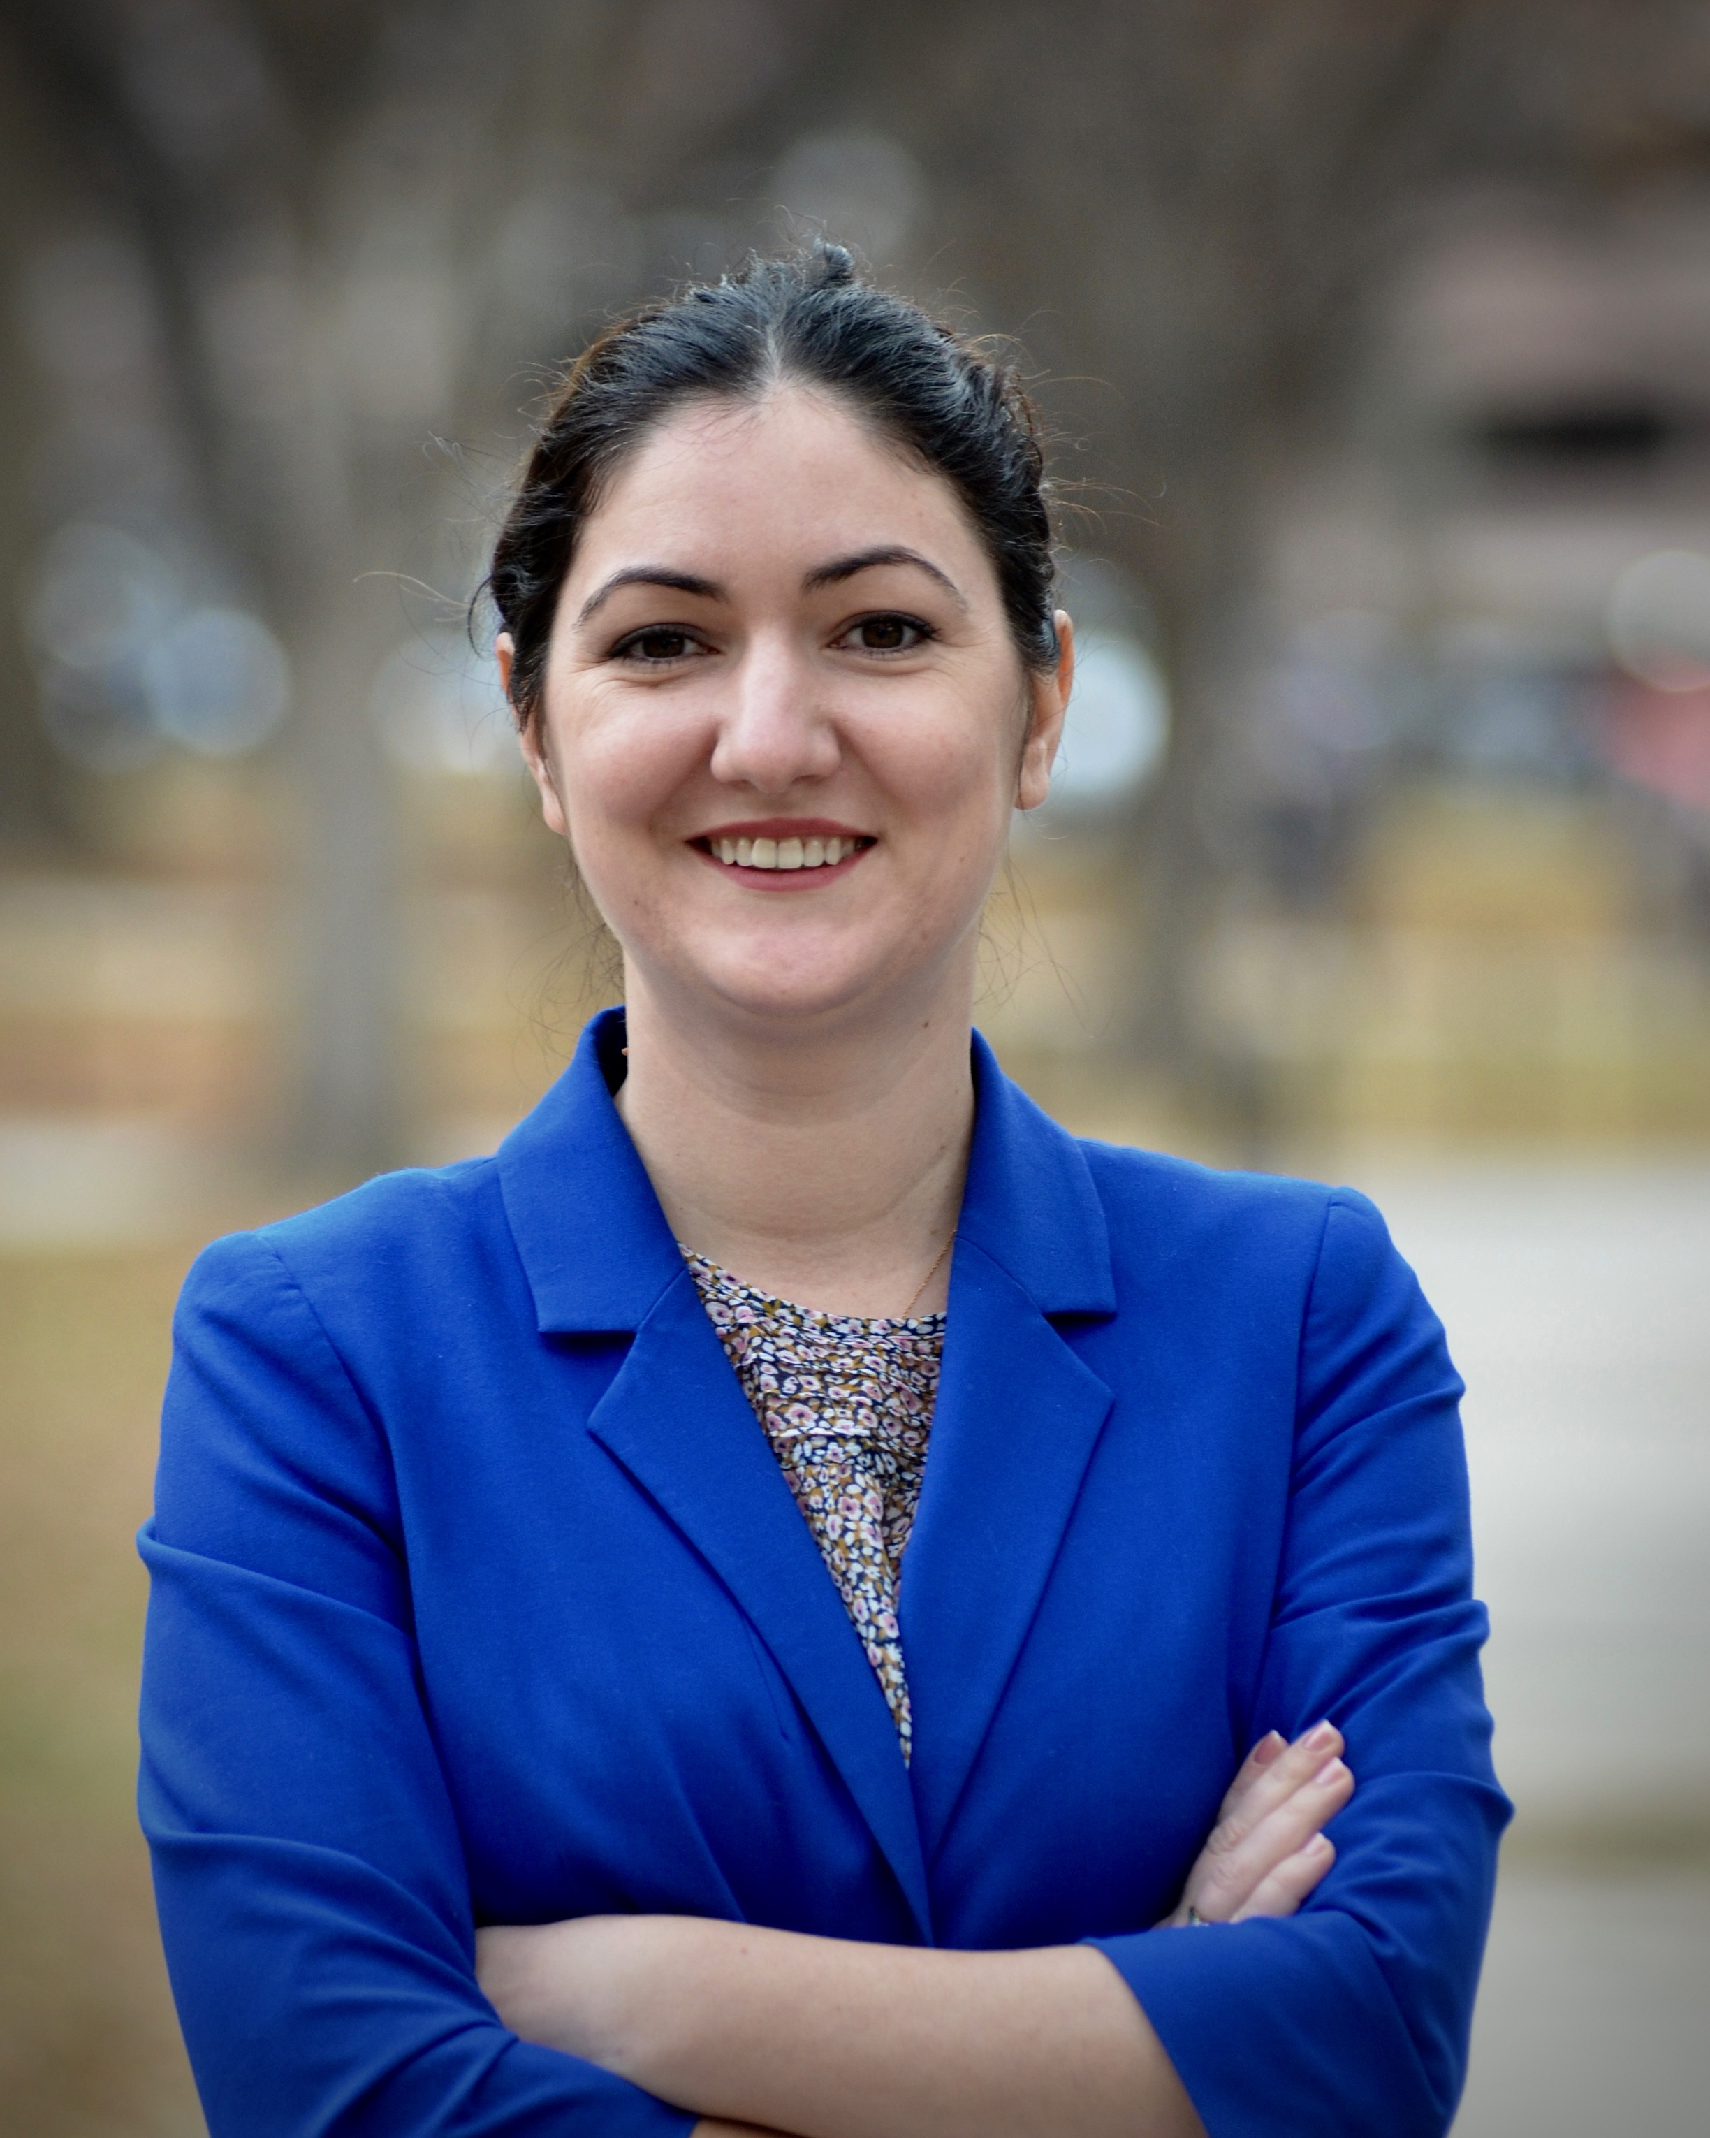
Unregulated? Think Again Unpacking all the meaningful ways in which “data privacy” law regulates Generative AI
PPAI Workshop
AAAI Conference
Vancouver
February 26, 2024
Dr Gabriela Zanfir-Fortuna
VP Global Privacy
Future of Privacy Forum
Notes:
Customize with your Title, headshot, Name and title

Slide 2
The historical argument
2. The legal argument
3. The global enforcement development
4. The outlook from enforcers
FPF.org

Slide 3
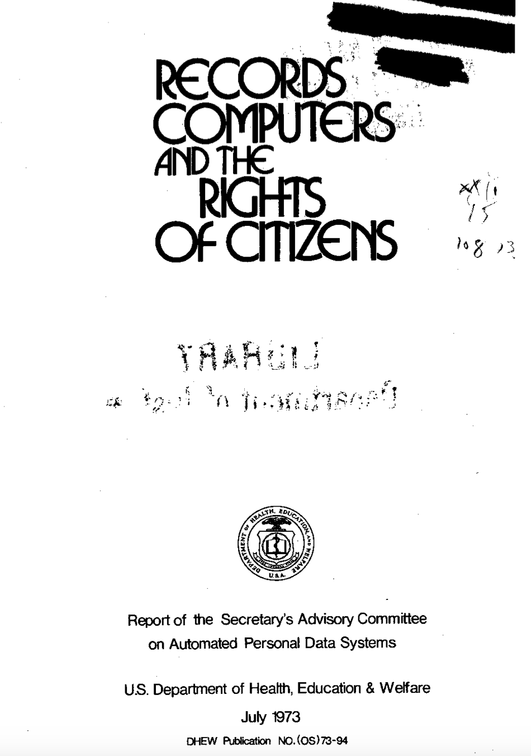
1. The historical argument
“The use of automated data systems containing information about individuals is growing in both the public and private sectors….
At the same time, there is a growing concern that automated personal data systems present a serious potential for harmful consequences, including infringement of basic liberties.
This has led to the belief that special safeguards should be developed to protect against potentially harmful consequences for privacy and due process”. P. viii (Records, Computers and the Rights of Citizens, July 1973)
FPF.org

Slide 4
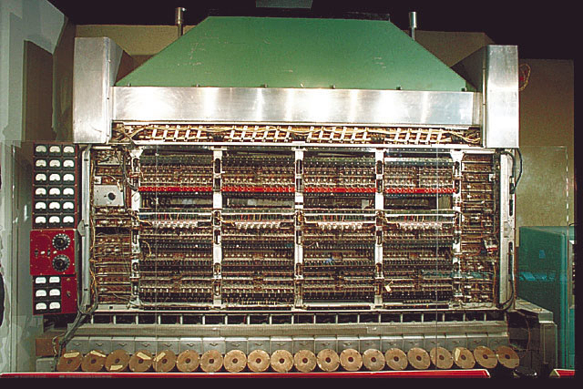

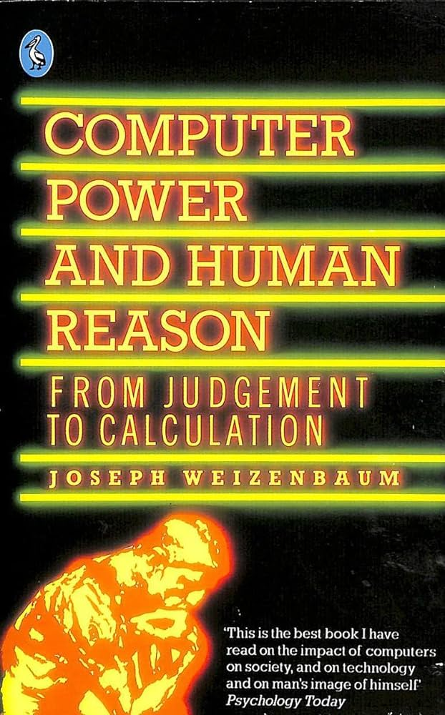
(Some) members of the FIPPs Committee
Willis Ware, one of the creators of
the first electronic computer at the Institute of Advanced Studies at Princeton (the IAS machine)
Late 1940s – Early 1950s
Arthur Miller, Law Professor and
Author of the Assault on Privacy:
Computers, Data Banks and
Dossiers, 1971
Joseph Weizenbaum
Creator of the first Chatbot, ELIZA
1966
FPF.org

Slide 5
The 1973 Fair Information Practice Principles
Transparency
There must be no personal data record-keeping systems whose very existence is secret.
Access
2. There must be a way for a person to find out what information about the person is in a record and how it is used.
Purpose limitation
3. There must be a way for a person to prevent information about the person that was obtained for one purpose from being used or made available for other purposes without the person's consent.
Accuracy and correction
4. There must be a way for a person to correct or amend a record of identifiable information about the person.
Integrity and Security
5. Any organization creating, maintaining, using, or disseminating records of identifiable personal data must assure the reliability of the data for their intended use and must take precautions to prevent misuses of the data.
FPF.org

Slide 6
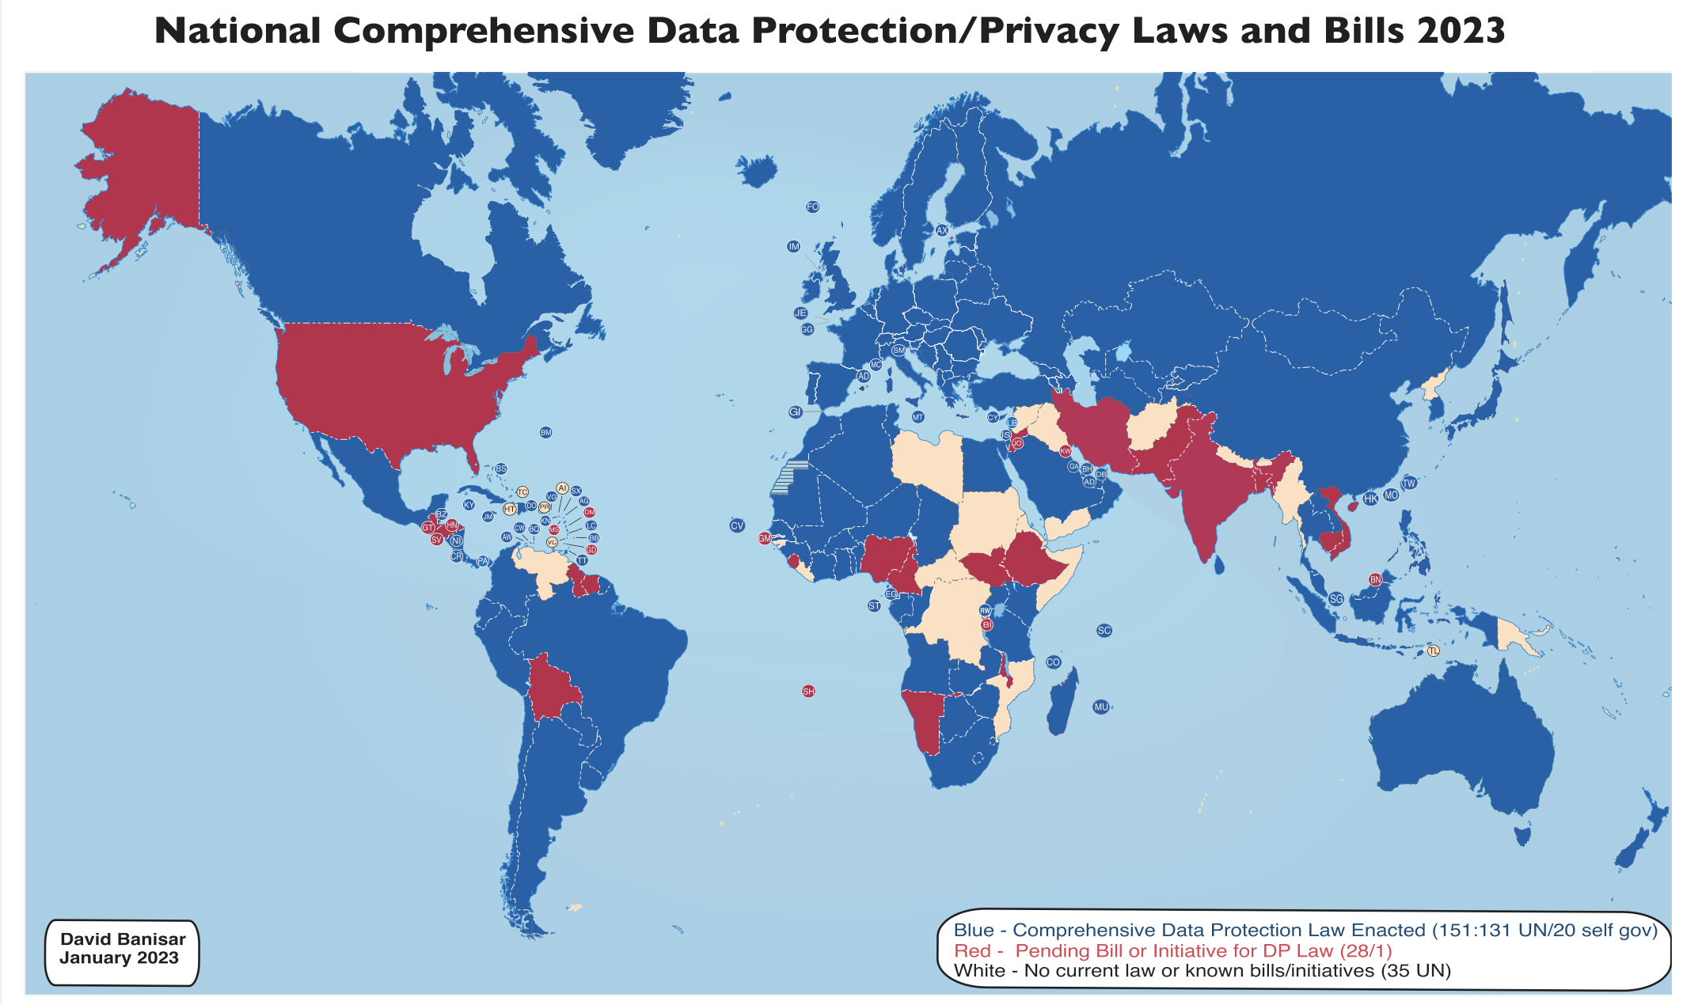
FPF.org

Slide 7
2. The legal argument
Data Protection Law is triggered when “processing” of “personal data” takes place.
“Personal Data” = any information relating to an identified or identifiable natural person (‘data subject’); an identifiable natural person is one who can be identified, directly or indirectly, in particular by reference to an identifier such as a name, an identification number, location data, an online identifier or to one or more factors specific to the physical, physiological, genetic, mental, economic, cultural or social identity of that natural person;
(Article 4(1) GDPR)
FPF.org

Slide 8
Of note: Publicly Available Personal Data is not excluded from the scope of data protection law, outside the United States
Inferences (Court of Justice of the EU in OT, 2023: the name of one’s spouse can be sensitive information because it may reveal sexual orientation)
Static IP addresses (CJEU in Scarlet extended)
Dynamic IP addresses in some situations (CJEU in Breyer)
Location data (CJEU in Digital Rights Ireland)
Metadata of electronic communications (CJEU in Digital Rights Ireland)
VIN numbers in some situations (CJEU in SCANIA)
FPF.org

Slide 9


Processing = any operation or set of operations which is performed on personal data or on sets of personal data, whether or not by automated means, such as collection, recording, organisation, structuring, storage, adaptation or alteration, retrieval, consultation, use, disclosure by transmission, dissemination or otherwise making available, alignment or combination, restriction, erasure or destruction;
(Article 4(2) GDPR)
Magic?
If it is performed through automated means on personal data = processing
FPF.org

Slide 10
3. The Global enforcement development
Garante (Data Protection Authority) - Italy | 30 March 2023
European Data Protection Board - EU | 13 April 2023
Federal Office of the Privacy Commissioner - Canada | 4 April 2023
Ibero-American Network of DPAs | 8 May 2023
Personal Information Protection Commission - Japan | 1 June 2023
AP (Data Protection Authority) - Netherlands | 7 June 2023
ANPD - Brazil | 27 July 2023
FTC - US | July 2023
Personal Information Protection Commission - South Korea | 27 July 2023
GIODO (Data Protection Authority) - Poland | August 2023
FPF.org

Slide 11

Issues highlighted by Garante’s initial ban decision
Lack of notice to users whose data have been collected and processed through the ChatGPT service
Lack of legal basis in relation to the collection of personal data and their processing for the purpose of training the algorithms
Processing inaccurate personal data as output when users use ChatGPT
Absence of age verification for users
Potential violation of Article 25, Data Protection by Design and by Default
Temporary ban order,
30 March 2023
FPF.org

Slide 12
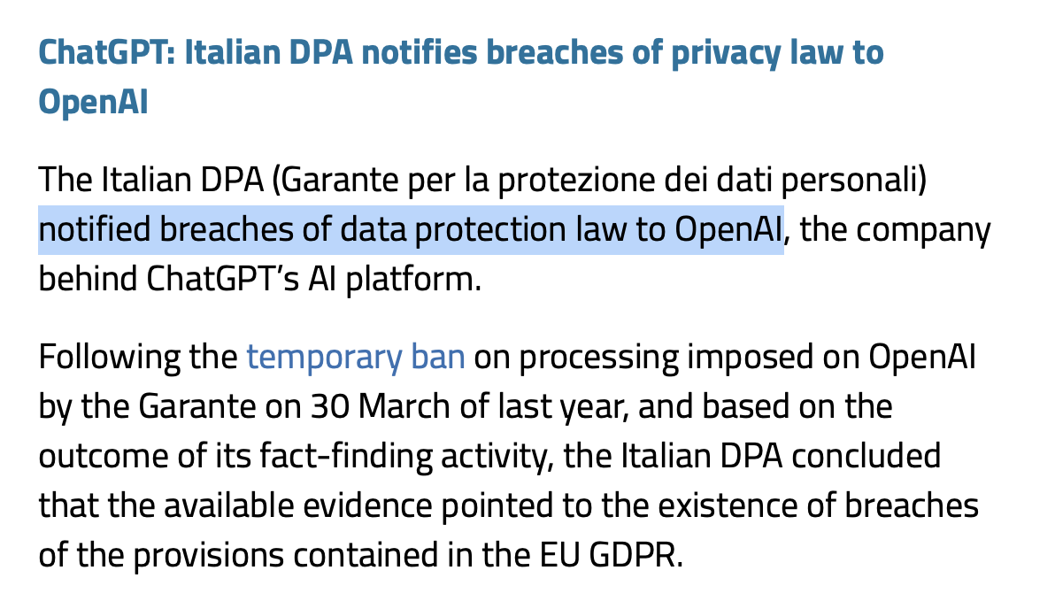
The ban was suspended 3 weeks later, after initial changes were promised, including tools to be made available for people to object to processing, or to ask for correction of data
The Garante announced on 29 January, 2024, it concluded its investigation and found GDPR breaches. It gave OpenAI 30 days to respond to these findings.
FPF.org

Slide 13

4. The Outlook from enforcers
Resolution on Generative Artificial Intelligence Systems
adopted October 2023
Lawful basis for processing
Purpose specification and use limitation
Data minimization
Accuracy
Transparency
Security
Data Protection by Design and by Default
Rights of the Data Subject
Accountability
FPF.org

Slide 14
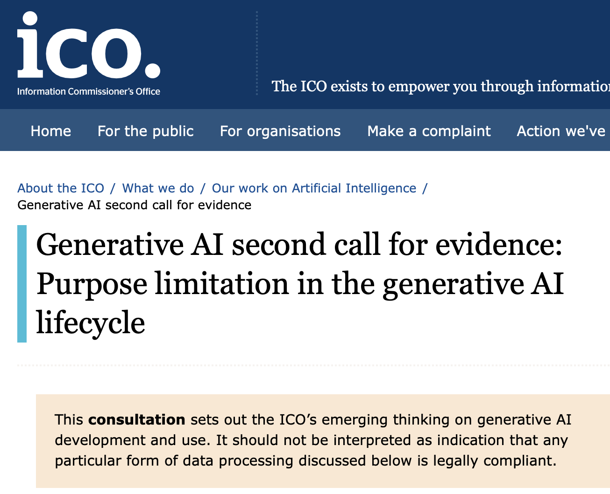
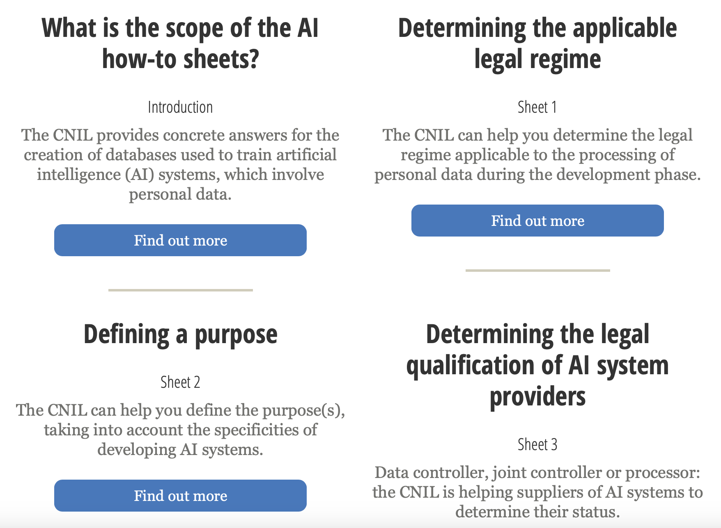
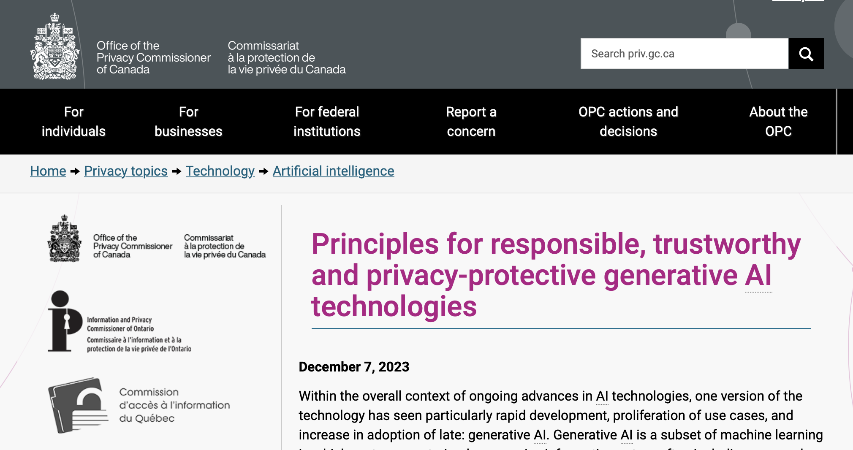
UK ICO, today
French Data Protection Authority, CNIL (October 2023)
Canada’s Federal Privacy Commissioner
December 2023
FPF.org

Slide 15
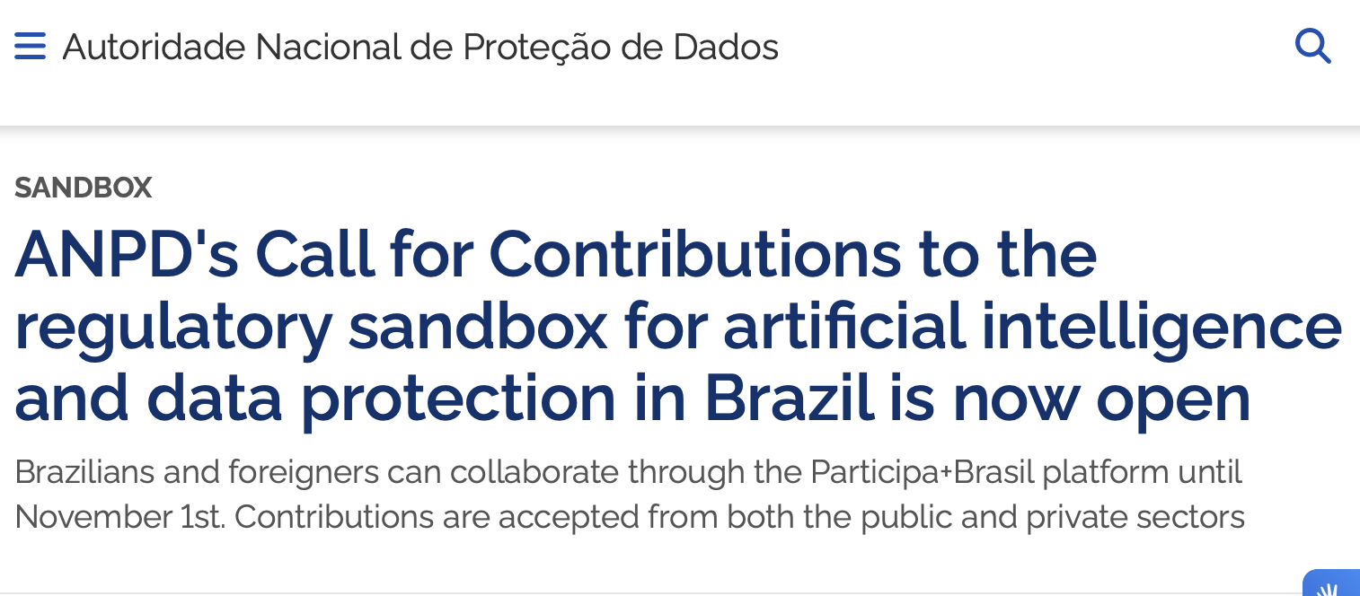
South Korea’s Privacy Commission announced Guidelines to be adopted in 2024 with a focus on processing personal data in the context of AI:
Criteria for pseudonymization of unstructured data
Regulation for biometric data
Usage of publicly available data
Usage of visual data captured with mobile image processing devices
AI transparency
Usage of synthetic data
FPF.org

Slide 16
Thank you!
fpf.org
@futureofprivacy
Dr Gabriela Zanfir-Fortuna
gzanfir-fortuna@fpf.org
@gabrielazanfir
Notes:
Customize with your image, name, email and Twitter handle (optional)

